Slide 1



Partner
Marketplace

Slide 2
✱
Who we are?
✅ Value Markers Consultancy is a trusted strategic advisory firm specializing in business transformation, digital innovation, and marketplace development.
Executive Summary
✅ We empower organizations to scale faster by leveraging platform ecosystems, agile methodologies, and data-driven insights.
✱
Our expertise
✅ Proven track record in designing and executing scalable digital ecosystems
✅ Data-driven strategies to unlock new revenue opportunities
✅ Strong industry insights to optimize value chains and drive growth
2

Slide 3







Our Team
Our team is a diverse blend of creative minds, strategic thinkers, and industry experts committed to propelling your business to new heights.
With a passion for innovation and a collective dedication to excellence, we bring a wealth of experience and fresh perspectives to every project.
Praveen Anandaselvam
Reehen Mehta
Anu Karukayil
Adeayo Hassan
Guffran Mohammad
Pamela Basilio Granillo
3

Slide 4
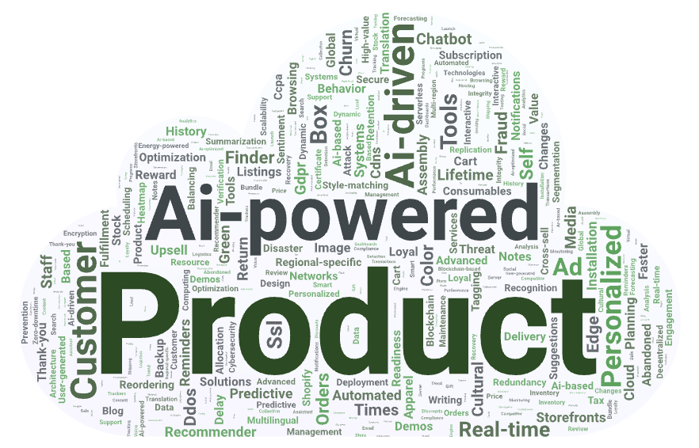
100 Different Ideas
Shopify Partner Marketplace
4

Slide 5

Shopify Partner Marketplace
A collaborative platform enabling merchants and partners to co-sell, bundle services, and enhance fulfillment.
Solution Options
AI-Powered Virtual Shopping Concierge
An intelligent assistant using AI, NLP, and AR to provide personalized shopping experiences, product recommendations, and virtual try-ons across multiple platforms.
5

Slide 6
Marketplace Comparison
WooCommerce Multi-Vendor
BigCommerce App Marketplace
Wix App Market
Open-source with full code access for flexible customization.
Strong multi-vendor support via plugins.
Large user base within the WordPress ecosystem, offering opportunities.
Hosted SaaS with the revenue-sharing model.
API access is required for implementation, though it is less flexible than WooCommerce
Moderate developer entry with technical needs and app approval process.
Easy entry with low-code/no-code tools for developers.
Limited support for multi-vendor setups.
The ecosystem is closed but growing and focused on website enhancements.
7

Slide 7
Strengths
Weaknesses
Native Shopify integration
AI-powered matchmaking
Multiple revenue streams
Global reach
Better security & reliability
Limited to Advanced & Plus
No direct multi-channel integration
Fraud risk & quality control
Pre-screened integrations
SWOT
Analysis
Opportunities
Threats
Expand to fulfillment & services
Leverage AI & analytics
Cross-platform selling
Flexible subscription tiers
Competitors may replicate features
Regulatory risks
Merchant resistance to fees
8

Slide 8
Balance Scorecard
Financial
Customer
Revenue growth & projections
Profitability & market reach
Merchant collaboration experience
Collaboration retention & loyality
Internal Process
Learning & Growth
Operational efficiency & integration
Fraud prevention & dispute handling
AI-Driven expansion & innovation
Merchant education & enablement
10

Slide 9
✱
Enhancing commercial collaboration
✅ Shopify supports 5.17M+ active stores, yet lacks a native merchant collaboration ecosystem.
✅ The Shopify Partner Marketplace bridges this gap by enabling merchants to discover, collaborate, and co-sell.
The Initiative
✅ This initiative unlocks new revenue streams, boosts merchant retention, and strengthens Shopify’s edge.
Shopify Partner Marketplace
✱
Why now?
✅ 67% of global e-commerce sales occur via online market
✅ B2B e-commerce is growing at 18.7% CAGR through 2030
✅ Shopify’s GMV grew 22% YoY in Q2 2024, creating growth opportunities
11

Slide 10
🟨 | Initiation: Identify stakeholders, define KPIs, success metrics.
🟨 | Elicitation: Workshops with partners and merchants, collect requirements.
🟨 | Analysis: Prioritize features using MoSCoW; map needs to features.
🟨 | Design: Build wireframes, validate with users, and refine iteratively.
🟨 | Validation: UAT, feedback sessions, compliance testing.
🟨 | Implementation Support: Training, rollout support, post-launch feedback.
Business Analysis Phase
Overview of phases
12

Slide 11
Business Stakeholder
Plan for engagement strategy
Internal stakeholders
External stakeholders
Engagement tools
Feedback
loop
Monitoring
Product, Engineering, Marketing, Support, Leadership
Shopify Patners,
Merchants,
Legal Authorities
JIRA, Miro, Figma, Google Forms, Webinars
Surveys, Pilot Testing, Workshops, UAT
Participation Metrics, Milestone Reviews, Satisfaction Surveys
13

Slide 12
Shopify partner integration
Enable seamless onboarding and management of partners.
Project Scope
Development & profile lsting
Build a user-friendly marketplace for Shopify partners.
Allow partners to showcase their services and products.
Seamless merchant collaboration within the ecosystem
Reporting & issue resolution
¡
Track partner performance, sales, and customer engagement.
Offer premium education and support services for a fee.
14

Slide 13
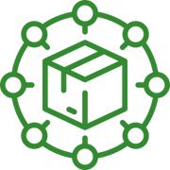
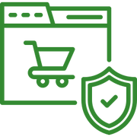



Business Requirements
Centralized Marketplace
Streamlined Onboarding
Real-time Analytics & Dashboards
Automated Revenue Share
Enhanced User
Experience
16

Slide 14
🟩 | Partner onboarding: Automated registration, validation, and profile management.
🟩 | Marketplace features: Search, filter, and AI-based recommendations for partner services.
🟩 | Transactions: Secure payments, automated commission calculations, and revenue sharing.
🟩 | Analytics: Real-time dashboards for performance tracking and paid insights.
🟩 | Support: Ticketing system, FAQs, and premium support packages.
🟩 | Monetization: Transaction fees, subscriptions, advertising, API fees, and analytics services.
Solution Requirement
Functional requirements
17

Slide 15
🟨 | Performance: Handle 10,000+ users, <2s page load, <3s transaction processing.
🟨 | Scalability: Support 10x growth and peak traffic.
🟨 | Security: PCI-DSS compliance, encryption, and regular audits.
🟨 | Usability: Intuitive design, WCAG compliance, and cross-device support.
🟨 | Reliability: 99.9% uptime, backups, and disaster recovery.
🟨 | Compliance: GDPR, CCPA, and Shopify API policies.
Solution Requirement
Non-functional requirements
18

Slide 16
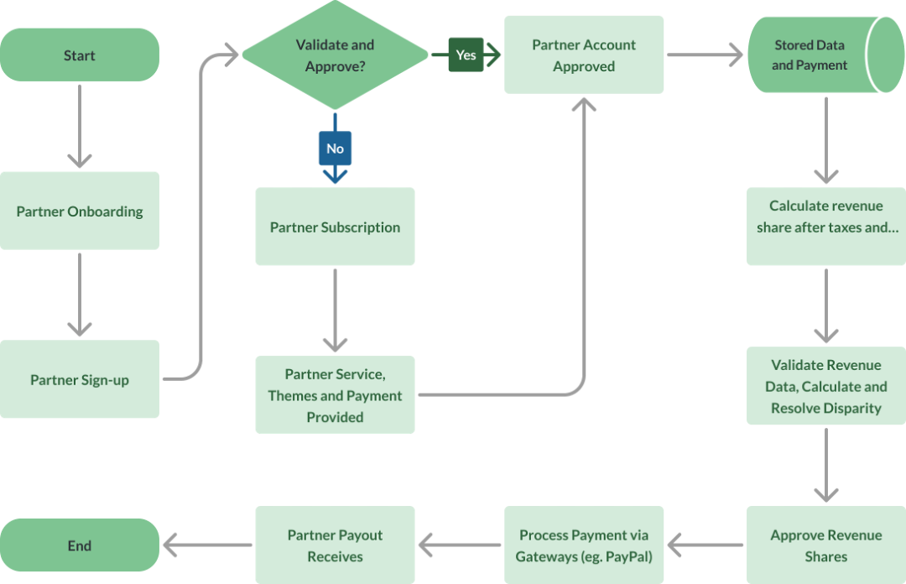
Revenue Sharing and Payment Process
Onboarding & approval: Partners register, provide business and payment details, and undergo validation for approval to participate in revenue sharing.
Revenue sharing & payment: Approved partners calculate revenue shares, resolve discrepancies, subscribe to services, and receive payments through gateways like PayPal or Stripe.
21

Slide 17
Year | Total Revenue | Total Expenses | Net Profit | ROI
5 | $65.1M | $69.1M | -$8.8M | -12.78%
10 | $135.4M | $90.8M | $24.0M | 26.46%
15 | $282.3M | $124.8M | $121.3M | 97.20%
20 | $634.1M | $180.8M | $349.0M | 192.99%
Financial Summary
Revenue grows nearly 10x from Year 5 to 20.
Marketplace becomes profitable by Year 10 and continues exponential return.
22

Slide 18
Metric | Year 5 | Year 10 | Year 15 | Year 20
Active Merchants | 10,000 | 25,000 | 45,000 | 70,000
Bundled Adoption | Modarate | High | Very High | Platform Standard
Partner Engagement | 40% | 75% | 90% | 95%
Merchant Growth & Engagement
AI matchmaking and bundled deals significantly boost merchant participation.
23

Slide 19




Strategic Advantages
Platform lock-in
Recurring revenue
Enhanced integrated revenue tracking & partner success tools
From subscriptions, ads, and API integrations
High scalability
Competitive moat
Scalable architecture supports 10x merchant expansion
Exclusive AI-driven matchmaking and performance-based discovery
24

Slide 20
Hybrid approach
Hybrid approach effectively combining predictive and adaptive methods for enhancement.
Business Analysis Approach
Predictive use
API compliance standards, Data privacy protocols, Onboarding flows optimization.
Adaptive use
UX Design principles, Advanced analytics, Partner discovery features enhancement.
Goal
Ensure alignment with business goals while staying flexible for feedback.
26

Slide 21
Risk For Merchant Marketplace
Merchant hesitation due to costs/complexity
Integration challenges with Shopify
Worries regarding expenses and the intricacy of technology.
Challenges in integrating with Shopify stores.
Lack of new features leading to attrition
Fraud & low-quality
merchants
Failure to provide updates causing employees to leave.
Damages the credibility of the marketplace.
27

Slide 22
Free trials & success stories
Offer free trials and highlight success stories to alleviate cost and complexity concerns.
Technical support & onboarding
Mitigation Strategies
Provide technical support and onboarding resources to ease integration challenges.
Networking events & webinars
Host networking events and webinars to gather feedback and optimize features.
Verification & review system
Implement merchant verification and review systems to maintain marketplace credibility.
28

Slide 23
Global boycotts of U.S. goods
Drive regional growth by promoting local integrations to meet shifting consumer preferences in Europe and Canada.
News
Implementation of targeted tariffs
Support merchants facing tariffs with cost-saving tools and boost marketplace adoption through online sales solutions.
Strategic growth amid global market shifts
Shopify stock surge boosts partner opportunities
Leverage Shopify’s 21% stock surge and rising demand by driving partner innovation to meet growing merchant needs.
32

Slide 24
Conclusion
Closes a critical gap in Shopify’s merchant ecosystem
Boosts trust and efficiency through automation and secure transactions
Drives smarter partnerships with AI-powered matchmaking and real-time insights
Fully scalable, aligned with Shopify’s long-term strategy and global vision
Accelerates growth by unlocking new revenue streams and improving retention
33

Slide 25
✅ 12 months implementation plan fully designed, realistic, and scalable.
✅ 193% ROI projected over 20 years through retention and monetization.
✅ $633B+ revenue potential unlocked via co-selling and smart partnerships.
✅ AI-powered matching reduces data loss by 40% and improves partner discovery.
✅ Choose The Value Markers to deliver this transformation with precision and speed.
Call of Actions
34

Slide 26
25-40%
Efficiency gains
100%
Compliance success rate
$2B+
Revenue Generated
250+
Certified Experts
What We Deliver
✱
Why us?
✅ We bring a clear, strategic vision for the Shopify Partner Marketplace
✅ Our framework ensures seamless stakeholder alignment
✅ We drive innovation, merchant collaboration, and long-term success
35

Slide 27
References
·Boak, J. (2025, March 26). Trump places 25% tariff on imported autos, expecting to raise $100 billion in tax revenues. Associated Press. Live: Trump slaps 25% tariffs on auto imports, warns EU and Canada will face 'far larger' levies if they ally
·Bloomberg News. (2025, March 25). Shopify takes steps to pull in billions from passive funds. https://www.bnnbloomberg.ca/business/2025/03/25/shopify-takes-steps-to-pull-in-billions-from-passive-funds/
·CertGuidance. (n.d.). Release and deployment management in ITIL & ITSM. https://www.certguidance.com/release-deployment-management-itil-itsm/
·Cyber Management Alliance. (n.d.). How to secure your Shopify store: A proven data protection guide. https://www.cm-alliance.com/cybersecurity-blog/how-to-secure-your-shopify-store-a-proven-data-protection-guide
·Grigorik, I. (2025, February 11). Powering Shopify’s High-Performance, PCI DSS v4 Compliant Checkout with Sandboxing. Shopify Canada. https://www.shopify.com/ca/partners/blog/checkout-compliance
·Guru99. (2023). How to create a test strategy document in software testing. https://www.guru99.com/how-to-create-test-strategy-document.html
·Guru99. (2023). What is risk-based testing? Process, types, and example. https://www.guru99.com/risk-based-testing.html
·International Software Testing Qualifications Board (ISTQB). (2021). ISTQB Glossary of Testing Terms. https://glossary.istqb.org/
36

Slide 28
References
·Shopify. (n.d.). About the Shopify Partner Program. Shopify Help Center. https://help.shopify.com/en/partners/about
·Shopify. (n.d.). Checklist of requirements for apps in the Shopify App Store. Shopify Developer Documentation. https://shopify.dev/docs/apps/launch/app-requirements-checklist
·Shopify. (n.d.). Compliance reports. Shopify Help Center. https://help.shopify.com/en/manual/privacy-and-security/account-security/compliance-reports
·Shopify. (n.d.). Data transfers. Shopify Help Center. https://help.shopify.com/en/manual/privacy-and-security/privacy/international-data-transfers
·Shopify. (n.d.). How to qualify for the Shopify Plus Certified App Program. Shopify Help Center. https://help.shopify.com/en/partners/plus-certified-app-program/certification
·Shopify. (n.d.). International data transfers. Shopify Help Center. https://help.shopify.com/en/manual/privacy-and-security/privacy/international-data-transfers
·Shopify. (n.d.). Partner Program Agreement. https://www.shopify.com/partners/terms
·Shopify. (n.d.). Powering Shopify’s High-Performance, PCI DSS v4 Compliant Checkout with Sandboxing. Shopify Canada. https://www.shopify.com/ca/partners/blog/checkout-compliance
37

Slide 29

Thank You

